Slide 1



Slide 2

How big do index funds need to be to destabilise markets?
Index funds invest in a basket of stocks in order to match the performance of an index, such as the S&P 500.
The resulting trading can move prices for reasons that have nothing to do with the fundamentals of the underlying stocks.

Slide 3

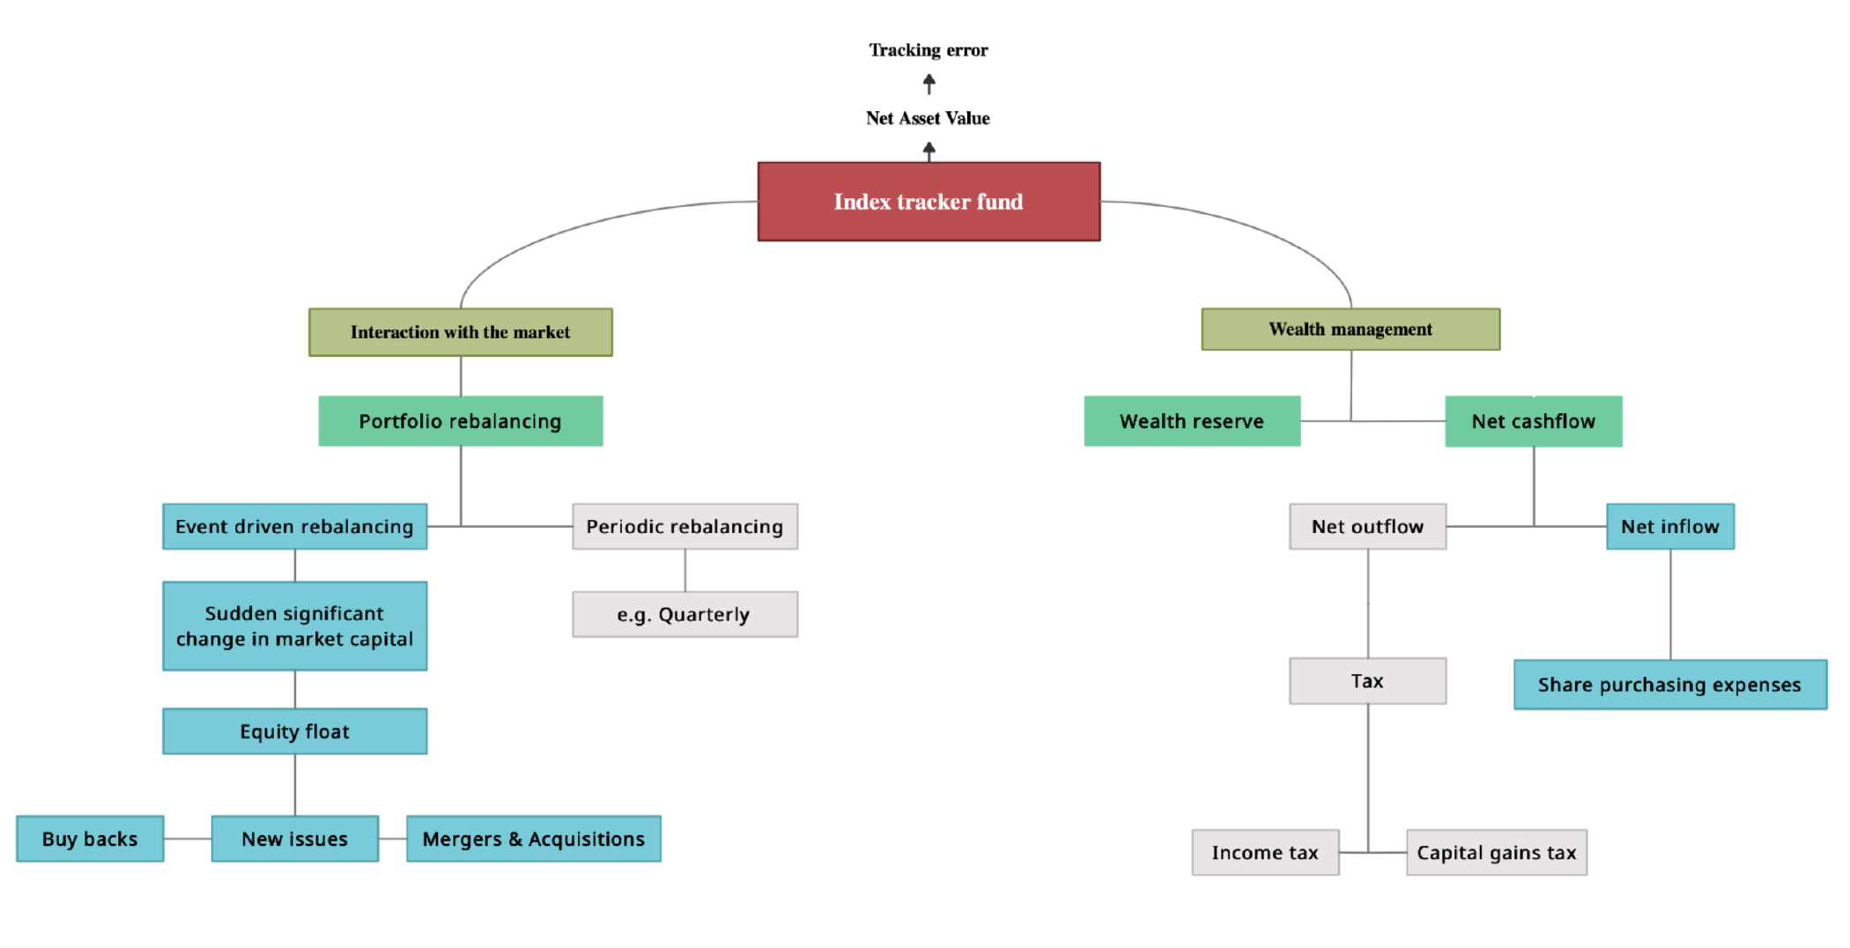
Internal operations of a passively managed investment fund ^{[3]}

Slide 4


Connection Home - This text is used for the template's hyperlinks – Don’t Delete
Multi-Asset Stock Market Ecology
Bond
Passive Trader
Risky Asset 1
div. 1
Market
div.2
Value Trader
Risky Asset 2
Trend Follower
Noise Trader

Slide 5
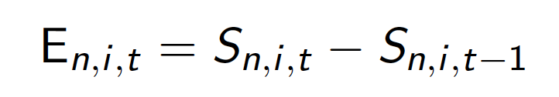
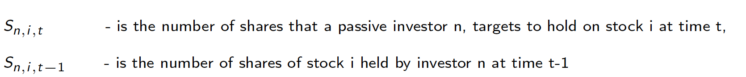
Connection 5 - This text is used for the template's hyperlinks – Don’t Delete
Passive Trader
This is the number of shares that the fund targets to end up holding minus what it currently holds

Slide 6

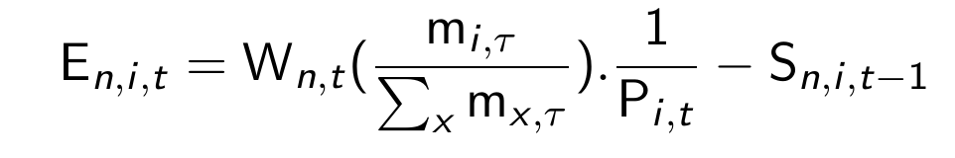
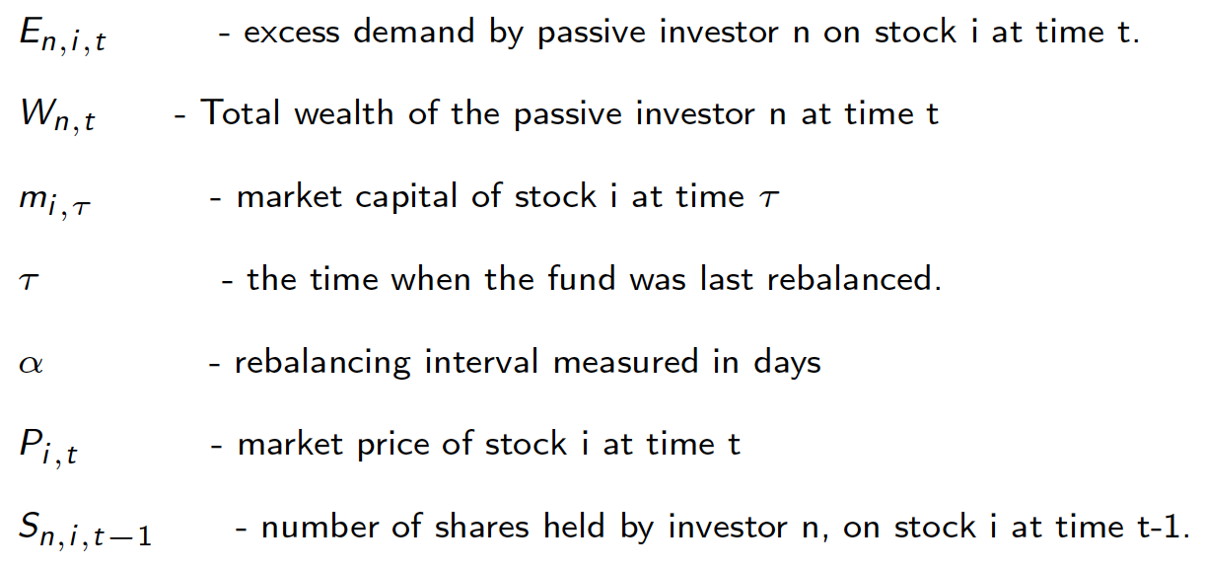
Connection 5 - This text is used for the template's hyperlinks – Don’t Delete
Passive Trader
The targeted holdings, , are a function of current wealth and the market capitalization ratio of the stock in
the overall stock market ^{[3]}

Slide 7
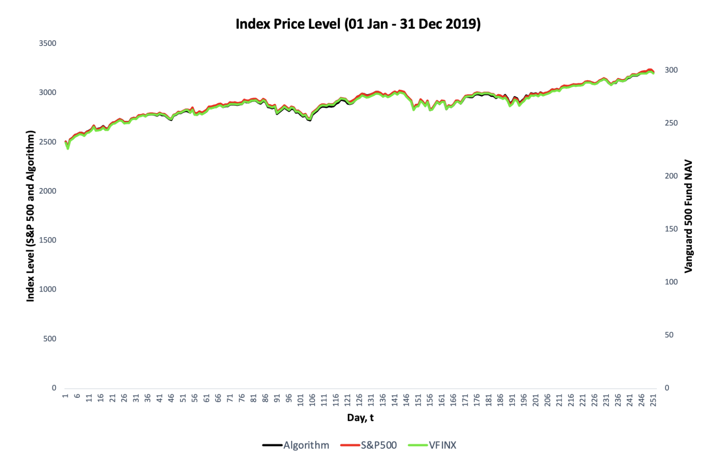
Connection 5 - This text is used for the template's hyperlinks – Don’t Delete
Passive Trader
Assessment of how well the algorithm’s portfolio tracks the S&P 500 index on Bloomberg data.
We use the Vanguard 500 Fund as a benchmark for the algorithm’s performance

Slide 8
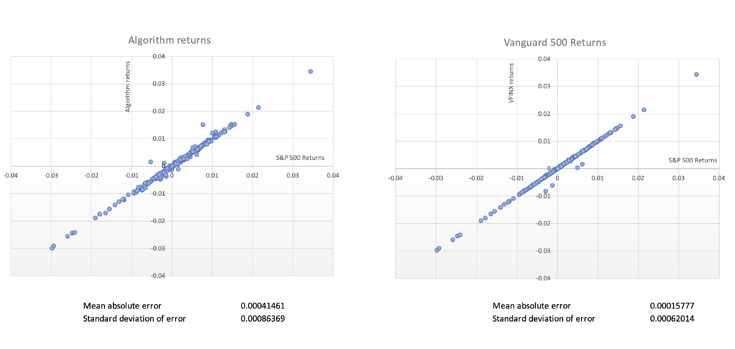
Connection 5 - This text is used for the template's hyperlinks – Don’t Delete
Passive Trader
Assessment of the returns from the algorithm’s portfolio compared to the S&P 500 index returns

Slide 9
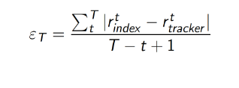

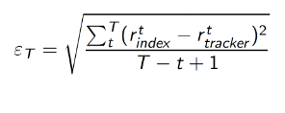
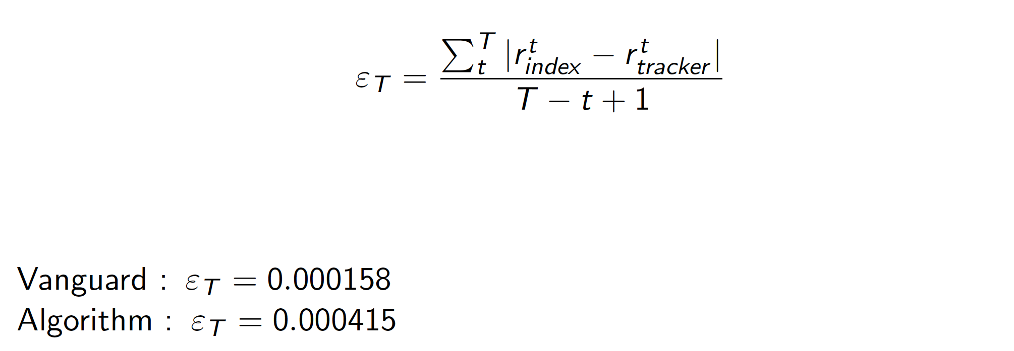
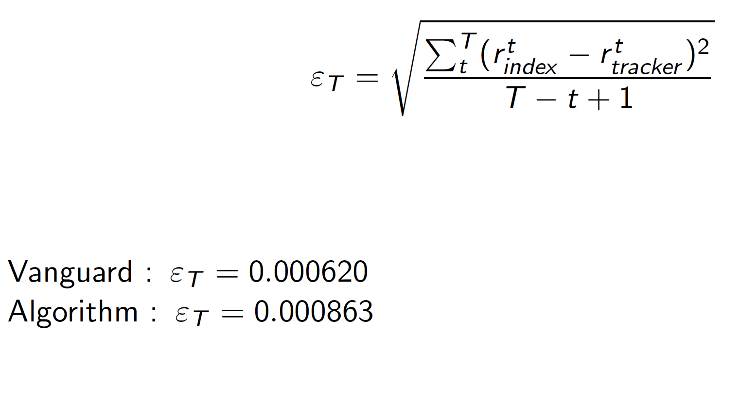
Connection 5 - This text is used for the template's hyperlinks – Don’t Delete
Passive Trader
Tracking error
Absolute tracking error
Standard deviation ^{[10]}

Slide 10
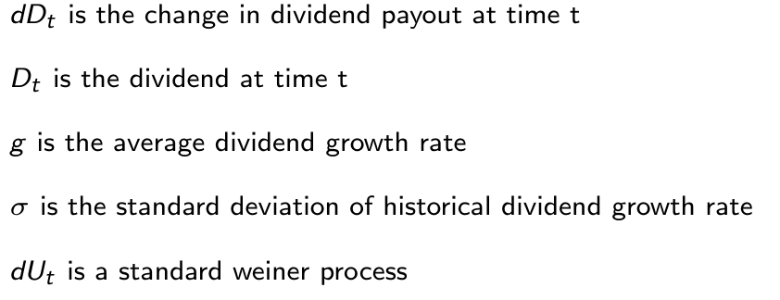
Connection 12 - This text is used for the template's hyperlinks – Don’t Delete
Risky Asset
The risky asset gives a dividend which, for simplicity we assume is payable continuously. We model the process as illustrated in Scholl et al (2020) ^{[11]}
To replicate empirical observations, we make the dividend process temporally correlated with its historical payouts.
We also correlate it cross-sectionally with the dividend processes of the other risky assets.

Slide 11
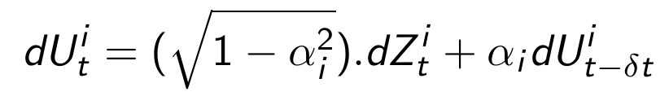




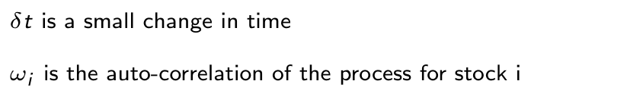
Connection 12 - This text is used for the template's hyperlinks – Don’t Delete
Risky Asset
We model temporal correlation by modifying the Weiner term by the function,
div
^{[12]}
This process is consistent with both the standard Weiner process and Ito’s lemma and one would find that,

Slide 12


Connection 12 - This text is used for the template's hyperlinks – Don’t Delete
Risky Asset
For cross sectional correlation, we do a Cholesky decomposition of the correlation matrix of the two assets ^{[2]}
We then multiply the Lower matrix, L by the uncorrelated Weiner processes, , and
end up with a cross sectionally correlated process

Slide 13
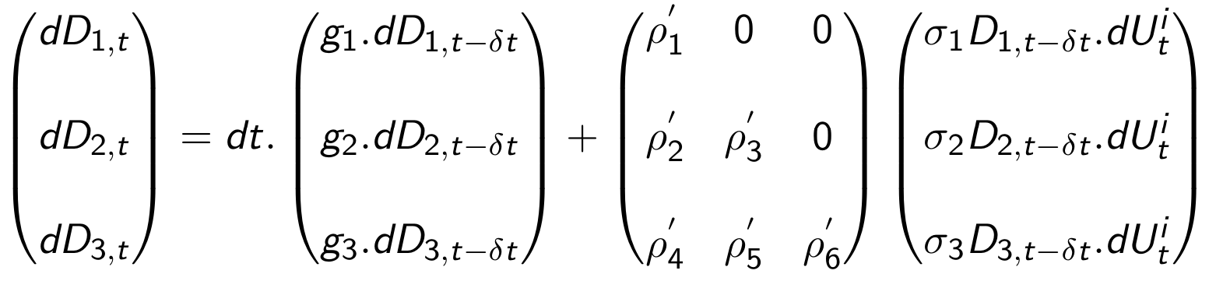
Connection 12 - This text is used for the template's hyperlinks – Don’t Delete
Risky Asset
The overall model

Slide 14
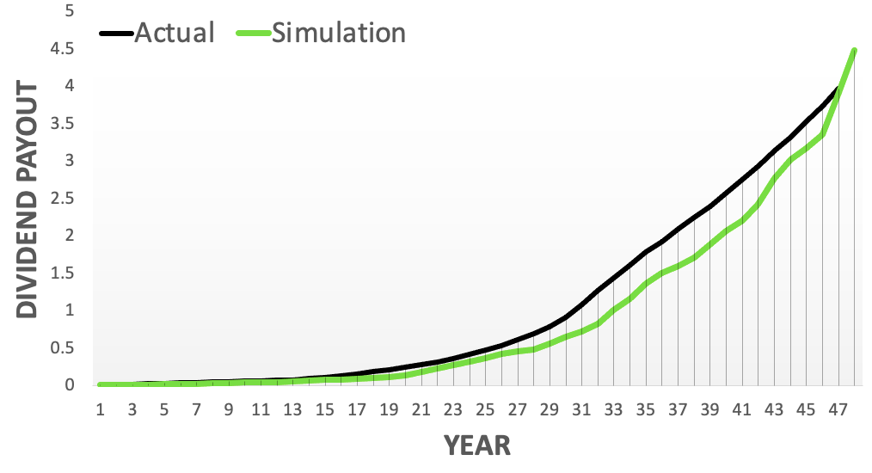
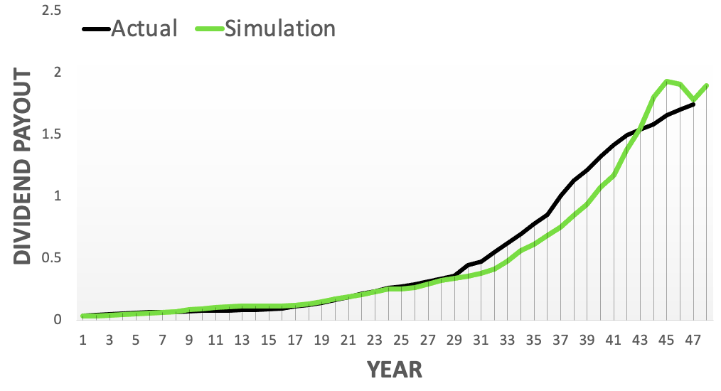
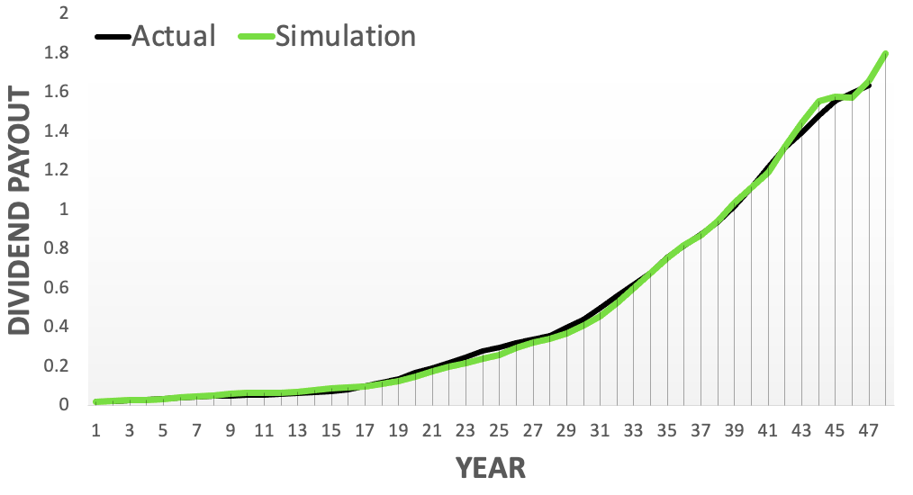


Connection 12 - This text is used for the template's hyperlinks – Don’t Delete
Risky Asset
The model’s simulation Vs. Actual data
JNJ
Coca-Cola
Colgate

Slide 15
Connection 8 - This text is used for the template's hyperlinks – Don’t Delete
Value Trader
The Value Trader has a fixed rule of allocating wealth across asset classes:
Bonds 40%
Risky assets 60%

Slide 16

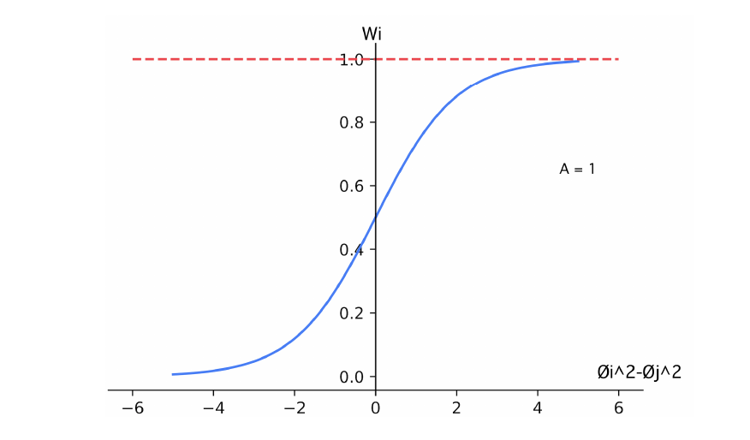

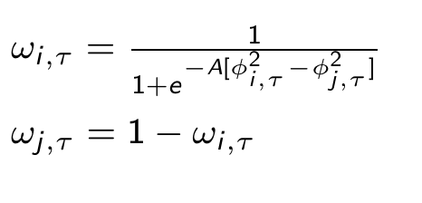

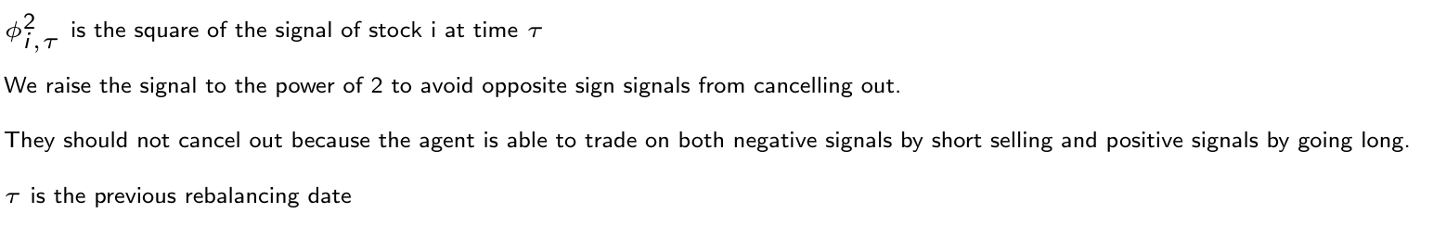

Connection 8 - This text is used for the template's hyperlinks – Don’t Delete
Value Trader
Within the Risky asset category, the 60% portion of wealth is further divided between the two risky assets
depending on the relative strength of each asset’s signal.
We model the investor’s choice by a sigmoid function
[5]

Slide 17
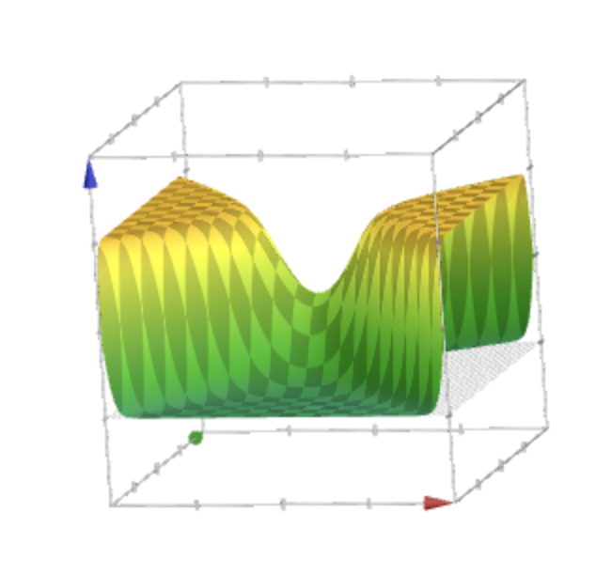





Connection 8 - This text is used for the template's hyperlinks – Don’t Delete
Value Trader
The function is better represented on a 3D-space
1
0.5
0
-0.5
Weight,
0
1
0
1
-1
-1

Slide 18
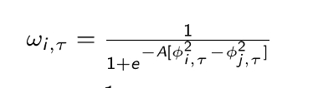
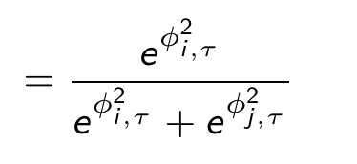
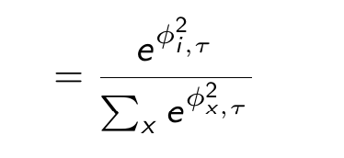

Connection 8 - This text is used for the template's hyperlinks – Don’t Delete
Value Trader
Re-engineering the sigmoid function gives us a more generic formula.
This result is identical to the choice function illustrated by McFadden, D. (1973)
[9]

Slide 19

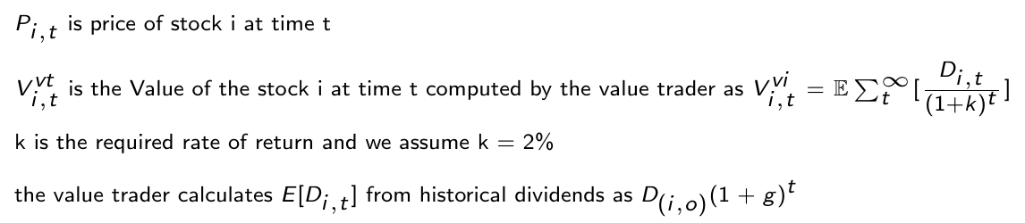
Connection 4 - This text is used for the template's hyperlinks – Don’t Delete
[11]
Value Trader
The Value trader believes market prices revert to the asset’s intrinsic value
[11]

Slide 20
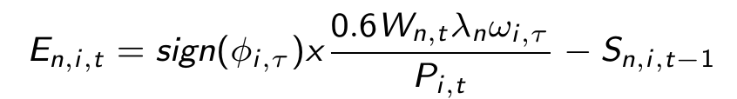
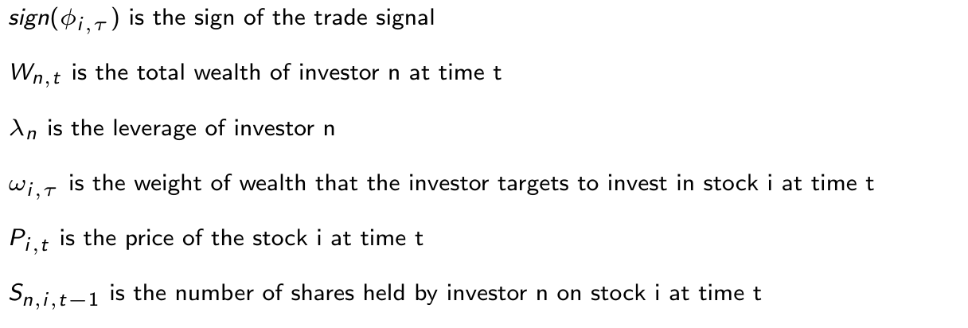
Connection 4 - This text is used for the template's hyperlinks – Don’t Delete
Value Trader
Excess demand is then computed as

Slide 21


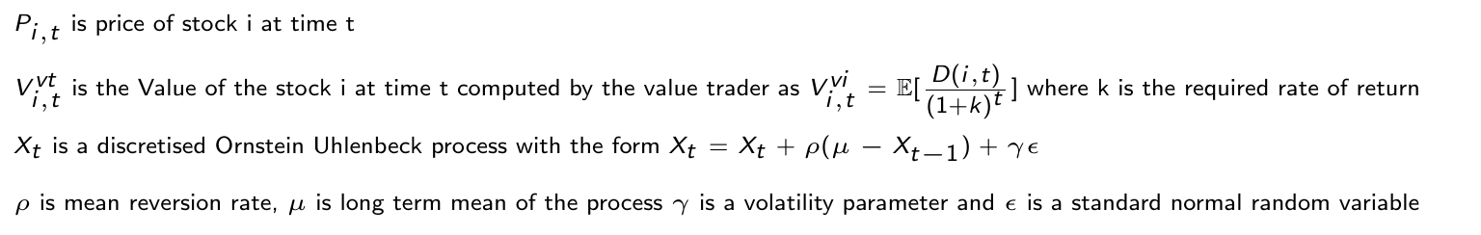
Connection 6 - This text is used for the template's hyperlinks – Don’t Delete
Noise Trader
Everything is identical to the Value trader’s rules of operation
except for the function used to compute the signal of a risky asset
[11]
Signal,

Slide 22


Connection 7 - This text is used for the template's hyperlinks – Don’t Delete
Trend Follower
Everything is identical to the Value trader’s rules of operation
except for the function used to compute the signal of an asset
[11]
Signal,

Slide 23
Connection 8 - This text is used for the template's hyperlinks – Don’t Delete
The Market
The market regulates communication in the ecology.
It sends quotes (asset prices) to traders, receives orders and computes new
asset prices depending on excess demand.
We use the Walrasian market clearing mechanism to determine new asset prices.
The algorithm searches for a price that minimizes the net excess demand.

Slide 24
Connection 23 - This text is used for the template's hyperlinks – Don’t Delete
Bond
We assume that the Bond gives a constant interest rate of 2% on all wealth invested as Bonds

Slide 25
References
^{[1]}Barde, Sylvain. (2016). Direct comparison of agent-based models of herding in financial markets. Journal of Economic Dynamics and Control. 73. 10.1016/j.jedc.2016.10.005.
^{[2]}Dereniowski D., Kubale M. (2004) Cholesky Factorization of Matrices in Parallel and Ranking of Graphs. In: Wyrzykowski R., Dongarra J., Paprzycki M., Waśniewski J. (eds) Parallel Processing and Applied Mathematics. PPAM 2003. Lecture Notes in Computer Science, vol 3019. Springer, Berlin, Heidelberg. https://doi.org/10.1007/978-3-540-24669-5_127
^{[3]}Ferri, Richard A. All about Index Funds : The Easy Way to Get Started. 2nd ed. New York: McGraw-Hill, 2007. Print. "All About-- " Ser. (McGraw-Hill Companies).
^{[4]}Franke, R., Westerhoff, F. Estimation of a Structural Stochastic Volatility Model of Asset Pricing. Comput Econ 38, 53–83 (2011). https://doi.org/10.1007/s10614-010-9238-7
^{[5]}Ghoulmié, F. & Bartolozzi, Marco & Mellen, Christopher & Di Matteo, Tiziana. (2007). Effects of diversification among assets in an agent-based market model - art. no. 68020D. Proceedings of SPIE - The International Society for Optical Engineering. 6802. 10.1117/12.758912.
^{[6]}J.-P. Nadal, D. Phan, M.B. Gordon, J. Vannimenus, “Multiple equilibria in a monopoly market with heterogeneous agents and externalities,” Quantitative Finance, 5, p. 557-568, 2005.Journal of Probability and Statistics. 2010. 10.1155/2010/543065.
^{[7]}Kahl C., Günther M. (2008) Complete the Correlation Matrix. In: Breitner M.H., Denk G., Rentrop P. (eds) From Nano to Space. Springer, Berlin, Heidelberg. https://doi.org/10.1007/978-3-540-74238-8_17
^{[8]}Lintner, John. “Distribution of Incomes of Corporations Among Dividends, Retained Earnings, and Taxes.” The American Economic Review, vol. 46, no. 2, 1956, pp. 97–113. JSTOR, www.jstor.org/stable/1910664. Accessed 15 June 2021.

Slide 26
^{[9]}McFadden, D. (1973) Conditional Logit Analysis of Qualitative Choice Behavior. In: Zarembka, P., Ed., Frontiers in Econometrics, Academic Press, 105-142.
^{[10]}Meade, Nigel, and Gerald R. Salkin. “Index Funds-Construction and Performance Measurement.” The Journal of the Operational Research Society, vol. 40, no. 10, 1989, pp. 871–879. JSTOR, www.jstor.org/stable/2583396. Accessed 15 June 2021.
^{[11]}Scholl, Maarten & Calinescu, Anisoara & Farmer, J.. (2020). How Market Ecology Explains Market Malfunction.
^{[12]}Sircar, S. K. R., Papanicolaou, G., Fouque, P. J., Sircar, K. R., Gómez Valderrama, P., Fouque, J. (2000). Derivatives in Financial Markets with Stochastic Volatility. United Kingdom: Cambridge University Press. pp.177-190
^{[13]}Sullivan, Rodney N and Xiong, James X., How Index Trading Increases Market Vulnerability (September 26, 2011). Financial Analysts Journal, Forthcoming, Available at SSRN: https://ssrn.com/abstract=1908227
^{[14]}Takahashi, Hiroshi. (2010). An Analysis of the Influence of Fundamental Values' Estimation Accuracy on Financial Markets.
Thank You!

